Slide 1
What makes a good Starbucks in los Angeles?
Applied Data Science Capstone project
The battle of neighborhoods
By Andrew turczyn
January 29, 2020

Slide 2
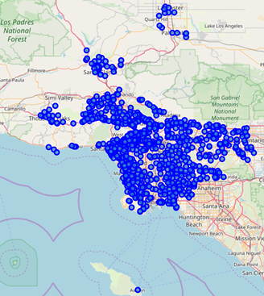
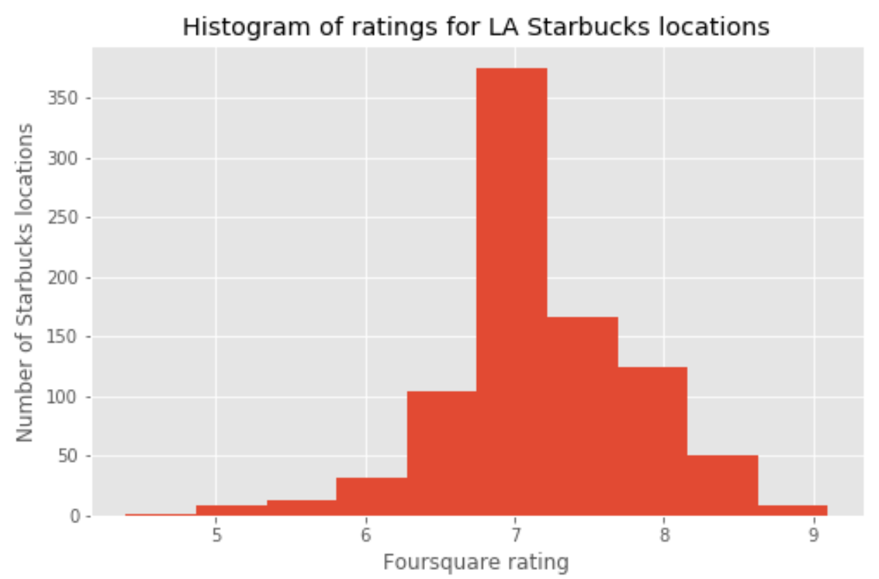
Starbucks locations in los angeles have a range of foursquare ratings
966 Starbucks locations in LA County:

Slide 3
Starbucks owners would be helped by higher foursquare rating
Existing Starbucks owners need a high rating to draw customers
New Starbucks owners need to understand neighborhood features that drive a high rating to help choose a location

Slide 4
Proposed predictors of foursquare rating:
Venue attributes
Examples:
Outdoor seating
Wi-fi
Delivery
Neighbor categories
Venues within one-tenth of a mile
Distance to nearest Starbucks

Slide 5
Data
List of all Starbucks locations in Los Angeles County
LA zip codes from the LA county website:
http://file.lacounty.gov/SDSInter/lac/1031552_MasterZipCodes.pdf
Use geocoder to map postal codes to latitude/longitude
Foursquare ‘search’ query by latitude/longitude for Starbucks in each zip
Starbucks location info
Foursquare ‘venues’ query by store ID
Capture store rating, list of attributes
Immediate neighbor category types for each Starbucks
Foursquare ‘search’ query by latitude/longitude for 5 nearest venues
Capture category ID and category name
Distance to the nearest Starbucks
Use geodesic function from geopy.distance
Calculate straight-line distance between each pair of Starbucks

Slide 6
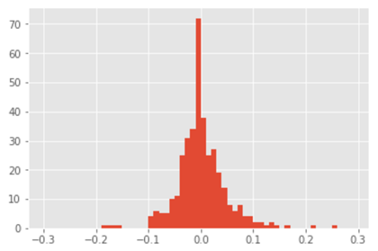
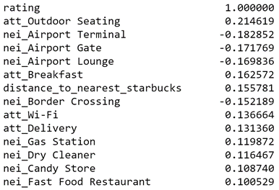
Venue attributes & neighbor categories have weak correlation with rating
Distribution of pearson correlation vs. rating
Features with highest correlation vs. rating

Slide 7
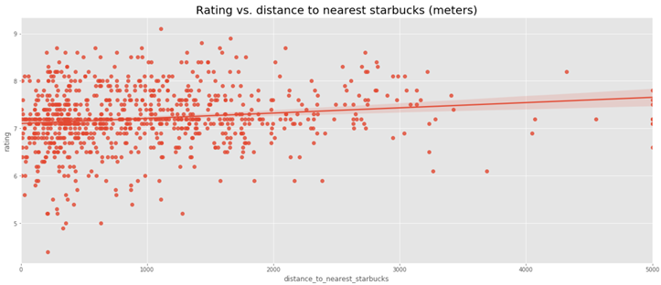
Distance to nearest starbucks has slightly positive correlation with rating
Foursquare rating tends to be higher for Starbucks not as close to another Starbucks

Slide 8
Linear regression model to predict rating
Model | Input features | R-squared over TRAIN | R-squared over TEST
1 | All features | 0.550 | -2.35 x 10¹⁶
2 | Features with correlation > 0.1 | 0.171 | 0.057
3 | Features with correlation > 0.05 | 0.336 | 0.013
4 | Features with correlation > 0.15 | 0.125 | 0.004
All have poor out-of-sample prediction over test dataset

Slide 9
recommendations
Current Starbucks owners: | New Starbucks owners:
Add the following services if possible: Outdoor seating Breakfast Wi-fi Delivery Private parking lot Remove the following services: ATMs TVs | Avoid locating near transportation sites: Airports (terminals, gates, lounges, and border crossings) Bus stations Train stations Avoid locating on college campuses: College theater, library, bookstore, residence halls University

Slide 10
Further analysis
Consider additional venue attributes to find features that may be more predictive of Foursquare rating
Store cleanliness
Staff friendliness
Average wait times
Store staffing levels
Customer volume
Analyze tips and user comments to find common attributes for stores that are rated very high/low

